Slide 1
Chapter 2B Parallel Sysplex

Slide 2
Objectives
In this chapter you will learn to:
  Discuss a Sysplex
  Coupling Facility
  Describe a Parallel Sysplex
  Explain how Parallel Sysplex can achieve continuous availability
  Use dynamic workload balancing
  Explain the single system image
  Describe resource adjustment across Systems in a Sysplex
Note to instructor : Some slides are animated - Use Power Point slide show
Only ~ 20 slides to present – the rest are extra

Slide 3
Basic v.s. Parallel Sysplex (SYStems comPLEX)
September 1990, IBM debuted the SYSPLEX introducing XCF services
allowing authorized applications to communicate with applications on the same
or other systems using specialized links.
BASIC – A shared couple data set used between all the images holds control
information and provides a mechanism for monitoring the status of the images
Parallel – This enhanced sysplex implementation provided the capability to use a
a specialized LIC operating environment called the coupling facility control
code (CFCC) offering speed and integrity to shared data.
While a basic sysplex is an actual entity, with a defined name (the sysplex
name), a parallel sysplex is more conceptual, that is a set of systems with
in a sysplex that all have access to the same one or more coupling facilities*.
* Described later in slides

Slide 4
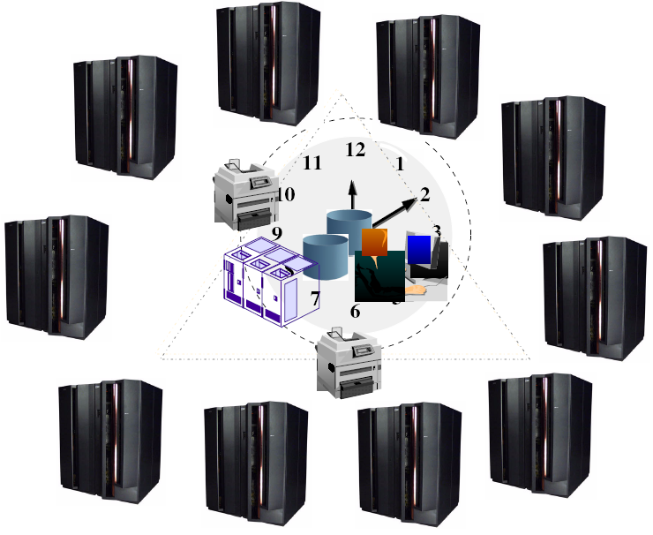
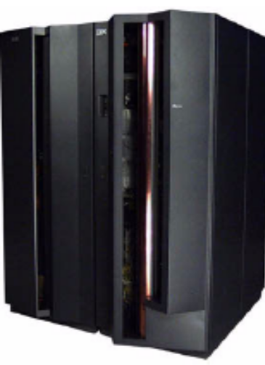
SYStems comPLEX or SYSPLEX
z/OS
Images
z/OS
Images
z/OS
Images
z/OS
Images
32 z/OS Images
z/OS
Images
z/OS
Images
z/OS
Images
z/OS
Images
z/OS
Images
z/OS
Images
Notes:
A Systems Complex, commonly called a sysplex, is one or more (up to 32) systems joined into a cooperative single unit using specialized hardware and software. It uses unique messaging services to exchange status information and can share special file structures contained within coupling facility (CF) data sets which we will discuss later.

Slide 5
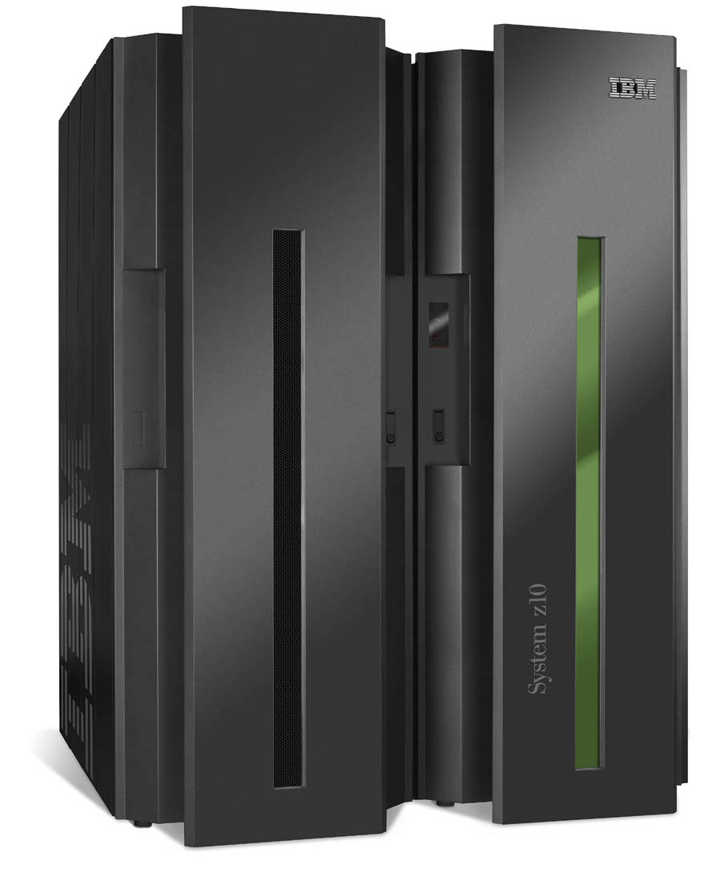
Sysplex Goal is a Single System Image

Slide 6
What a Sysplex can do for YOU…
It will address any of the following types of work:
  Large business problems that involve hundreds of end users, or deal with volumes of work that can be counted in millions of transactions per day.
  Work that consists of small work units, such as online transactions, or large work units that can be subdivided into smaller work units, such as queries.
  Concurrent applications on different systems that need to directly access and update a single database without jeopardizing data integrity and security.
Provides reduced cost through:
  Cost effective processor technology
  IBM software licensing charges in Parallel Sysplex
  Continued use of large-system data processing skills without re-education
  Protection of z/OS application investments
  The ability to manage a large number of systems more easily than other comparably performing multisystem environments

Slide 7
What else a Sysplex can do for YOU !
Platform for continuous availability so that applications can be available 24 hours a day, 7 days a week, 365 days a year
Ability to do more work
  Greater capacity
  Improved ability to manage response time
  Platform for further capacity and response time advances
Greater flexibility
  Ability to mix levels of hardware and software
  Ability to dynamically add systems
  An easy path for incremental growth
  Varied platforms for applications, including parallel, open, and client/server
Workload balancing
Notes:
Summary of these point

Slide 8
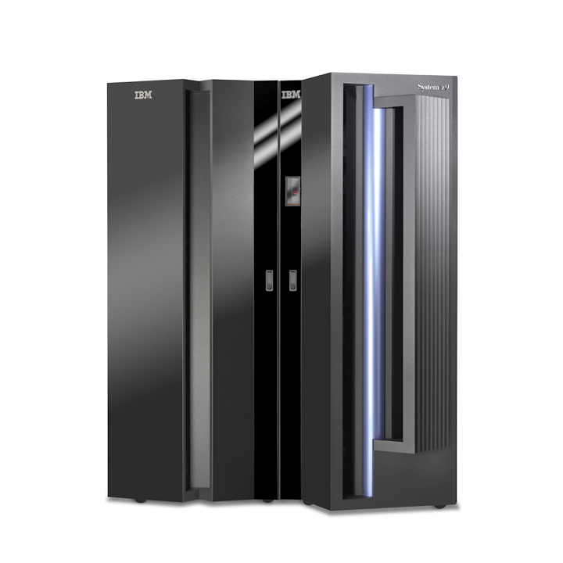

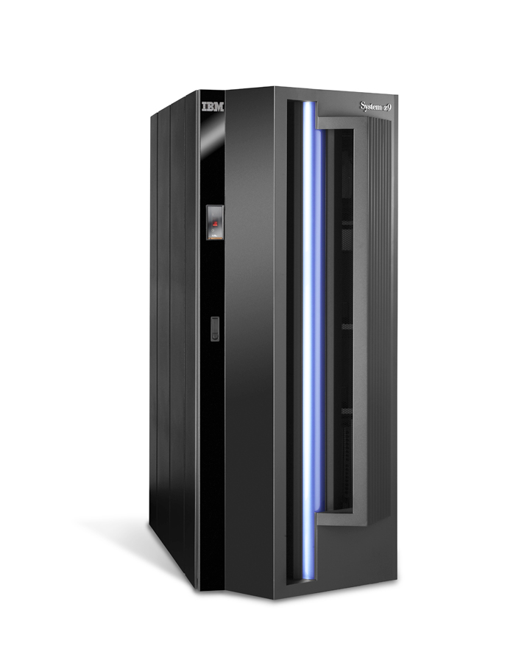
Sysplex Anatomy
A sysplex can include the following software and hardware:
1. z/OS Products include the cross-system coupling facility (XCF) component,
which enables authorized programs in a sysplex to communicate with programs
on the same MVS system or other MVS systems and the global resource
serialization component, which serializes sysplex resources.
2. Signaling paths between z/OS systems
- There must be at least two operational signaling paths
(one inbound and one outbound path) between each of the zOS systems
- The signaling paths can be defined through:
* Coupling facility list structures
* ESCON or FICON channels operating in CTC mode
* 3088 Multisystem Channel Communication Unit
3. Sysplex couple data set z/OS requires a DASD data set
- Shared by all systems in the sysplex.
- Sysplex couple data set, z/OS stores information related to the sysplex, systems,
XCF groups^{Ŧ}, and their members.
CF
^{Ŧ} An XCF group is the set of related members that a multisystem application defines to XCF. A multisystem application can be an installation-defined
program, an zOS component or subsystem, or a program product.
However, you can define a single system sysplex that does not require a sysplex couple data set.

Slide 9
Sysplex Anatomy… continued
4. Common time reference
When the sysplex consists of multiple zOS systems running two or more processors,
zOS requires that the processors be connected to the same Sysplex Timer.
- zOS uses the Sysplex Timer to synchronize TOD clocks across systems.
- For a multisystem sysplex defined on a single processor (under PR/SM™
or VM) the SIMETRID parameter in the CLOCKxx parmlib member must specify
the simulated Sysplex Timer identifier to synchronize timings for the zOS systems.
TOD Clocks: In a configuration with more than one CP, each CP may have a separate
TOD clock (as in the zOS’ Parallel Sysplex) or more than one CP may share the
same clock. To assist in the synchronization of the TOD clocks in a multisystem sysplex,
a new architected 128-bit extended time-of-day clock is available.
The extended clock format was required to provide the improved resolution necessary for the faster z10 processors as they become available. The extended time-of-day architecture ensures that when an application in a multisystem
sysplex environment requests a TOD value, XCF will always return a clock
value that is unique across the sysplex, regardless of the number of systems
in the sysplex.

Slide 10
Sysplex Coupling Facility - The glue for cross system data communication
Within the Coupling Facility, storage is dynamically partitioned into structures. z/OS services manipulate data within the structures.
Each of the following structures has a unique function:
Cache structure: Supplies a mechanism called buffer invalidation to ensure consistency of cached data. The cache structure can also be used as a high-speed buffer for storing shared data with common read/write access.
List structure: Enables authorized applications to share data that is organized in a set of lists, for implementing functions such as shared work queues and shared status information.
Lock structure: Supplies shared and exclusive locking capability for serialization of shared resources down to a very small unit of data.
IBM illustrations and
diagrams symbolizes a
Coupling Facility (CF)
using a triangle
Notes:
The technology that makes high-performance sysplex resource and data sharing possible is a combination of hardware and software services available in the supporting z/OS releases. A Coupling Facility can be a System z Coupling Facility standalone model or a logical partition of an IBM System z server. High-bandwidth fiber optic links known as Coupling Facility channels provide high-speed connectivity between the Coupling Facility and systems directly connected to it.
A Coupling Facility can be a zSeries Coupling Facility standalone model or a logical partition of an IBM zSeries server. High-bandwidth fiber optic links known as Coupling Facility channels provide high-speed connectivity between the Coupling Facility and systems directly connected to it.

Slide 11
Exploiters of the Coupling Facility (CF)
Authorized Applications
Information Management System Database (IMS DB)
Database 2 (DB2)
Virtual Storage Access Method
Notes:
Authorized applications, such as subsystems and z/OS components in the sysplex, use the Coupling Facility services to cache data, share queues and status, and access sysplex lock structures in order to implement high-performance data sharing and rapid recovery from failures. The subsystems and components transparently provide the data sharing and recovery benefits to their applications.
Some IBM data management systems that use the Coupling Facility include database managers and a data access method.
Information Management System Database Manager (IMS DB)
IMS DB is the strategic hierarchical database manager from IBM. It is used for numerous applications that depend on its high performance, availability, and reliability. A hierarchical database has data organized in the form of a hierarchy (pyramid). Data at each level of the hierarchy is related to, and in some way dependent on, data at the higher level of the hierarchy.
IMS database managers on different z/OS systems can access data at the same time. By using the Coupling Facility in a sysplex, IMS DB can efficiently provide data sharing for multiple z/OS systems and thereby extends the benefits of IMS DB data sharing. IMS DB uses the Coupling Facility to centrally keep track of when shared data is changed.
DATABASE 2 (DB2)
DB2 is the IBM strategic relational database manager. A relational database has the data organized in tables with rows and columns. DB2 data sharing support enables multiple DB2 subsystems within a sysplex to concurrently access and update shared databases. DB2 data
sharing uses the Coupling Facility to efficiently lock, to ensure consistency, and to buffer shared data. Similar to IMS, DB2 serializes data access across the sysplex through locking. DB2 uses Coupling Facility cache structures to manage the consistency of the shared data.
DB2 cache structures are also used to buffer shared data within a sysplex for improved sysplex efficiency.
Virtual Storage Access Method (VSAM) VSAM, a component of DFSMS, is an access method that gives CICS and other application
programs access to data stored in VSAM-managed data sets. DFSMS supports a VSAM data set accessing mode called Record Level Sharing (RLS). RLS uses the Coupling Facility to provide sysplex-wide data sharing for CICS and the other applications that use the new accessing mode. By controlling access to data at the record level, VSAM enables CICS application programs running in different CICS address space, and in different z/OS images, to share VSAM data with complete integrity. The Coupling Facility provides the high performance data sharing capability needed to handle requests from multiple CICS regions.
In addition to data management systems, there are other exploiters of the Coupling Facility, such as the z/OS Security Server (RACF®), JES2, WebSphere MQ, and so on. Transaction management systems also exploit the Coupling Facility to enhance parallelism.
_ _ _ _

Slide 12
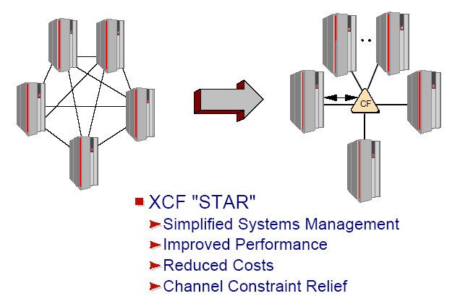
z/OS Resource Sharing
Earlier
configurations
Later
configurations

Slide 13
System z Sysplex Resource Sharing
This is not to be confused with application data sharing
This is sharing of physical system resources such as tape drives, catalogs, consoles
This exploitation is built into z/OS
Simplifies the management of the system

Slide 14
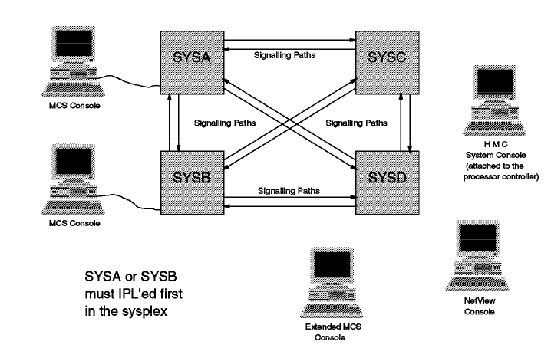
Console Sharing in Sysplex

Slide 15
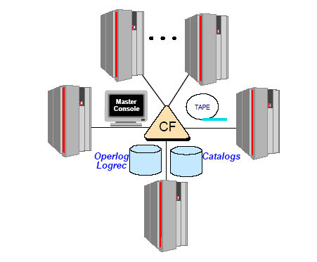
Resource Sharing via Coupling Facility

Slide 16
What is Parallel Sysplex
Builds on the strength of System z servers by linking up to 32 images to create the industry’s most powerful commercial processing clustered system
Every “cloned” application can run on every image
Hardware and software can be maintained non-disruptively
Innovative multi-system data-sharing technology
Direct concurrent read/write access to shared data from all processing nodes
No loss of data integrity
No performance hit
Transactions and queries can be distributed for parallel execution based on available capacity and not restricted to a single node
Notes:
A Parallel Sysplex is a symmetric sysplex using multisystem data-sharing technology. This is the mainframe’s clustering technology. It allows direct, concurrent read/write access to shared data from all processing servers in the
configuration without impacting performance or data integrity. Each LPAR can concurrently cache shared data in the CF processor memory through hardware-assisted cluster-wide serialization and coherency controls.

Slide 17
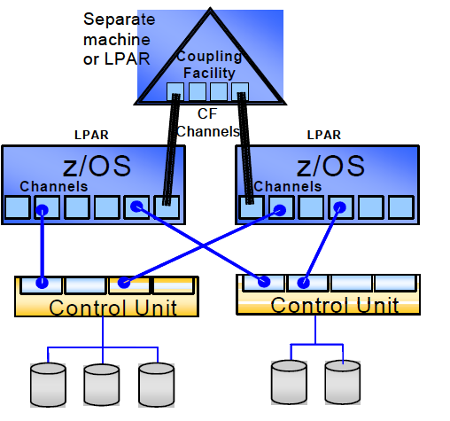
Parallel Sysplex
Notes:
Data Sharing
Lets look at how a shared access system works on the mainframe. We share workloads through multiple partitions and share all data through a common environment. Through the coupling facility we can share that data across multiple system images and application environments. That shared data happens because of I/O, disk devices are all shared through the integrated Channel-Architecture which has its foundation back to its original 360 design.
----- previous speaker notes -----
Connecting a large number of systems brings with it special considerations, such as how the large number of systems communicate and how they cooperate to share resources. These considerations affect the overall operation of z/OS systems. A sysplex significantly changes the way z/OS systems can share data. As the number of systems increase, it is essential to have an efficient way to share data across systems. The Coupling Facility enables centrally accessible, high-performance data sharing for authorized applications, such as subsystems and z/OS components, that are running in a sysplex. These subsystems and components then transparently extend the benefits of data sharing to their
applications. Use of the Coupling Facility substantially improves the feasibility of connecting many z/OS systems up to 32 with near linear scalability together in a sysplex to process work sharing data in parallel.
The concept of data sharing is not new. This data sharing capability follows the heritage of the mainframe’s design of share-everything architecture. Different applications within a system often need to access the same information, sometimes to read it and other times to update it. Sometimes several copies of the data exist, and with that comes the requirement of keeping all of the copies identical. If the system fails, you need a way to preserve the data with the most recent changes.
Data validity is controlled by a data management system. Within a single z/OS system, the data management system keeps track of which piece of data is being accessed or changed by which application in the system. It is the data management system’s responsibility to capture and preserve the most recent changes to the data, in case of system failure.
When two or more z/OS systems share data, each system has its own copy of a data management system. Communication between the data management systems is essential. Therefore, multisystem data sharing hinges on high-performance communication to ensure data validity among multiple data management systems, and it requires high-speed data accessing methods. Enabling the application for continuous availability gives you the opportunity to keep it running and stable even if one or more servers should become unavailable as a result of:
* Unplanned failures on one or some (but not all) of the servers
* Planned outages in the operations of one or some of the servers in connection with reconfiguration, upgrades,
maintenance
This feature of Z also provides for enhanced Total Cost of Ownership. There is little need to propagate or move data due to application locality. The Coupling Code allows for central processing of data without the concern of resource movement.
An enhancement is the System Managed Coupling Facility Duplexing which is a set of architectural extensions for Parallel Sysplex providing increase availability and access reliability for data structure redundancy.

Slide 18
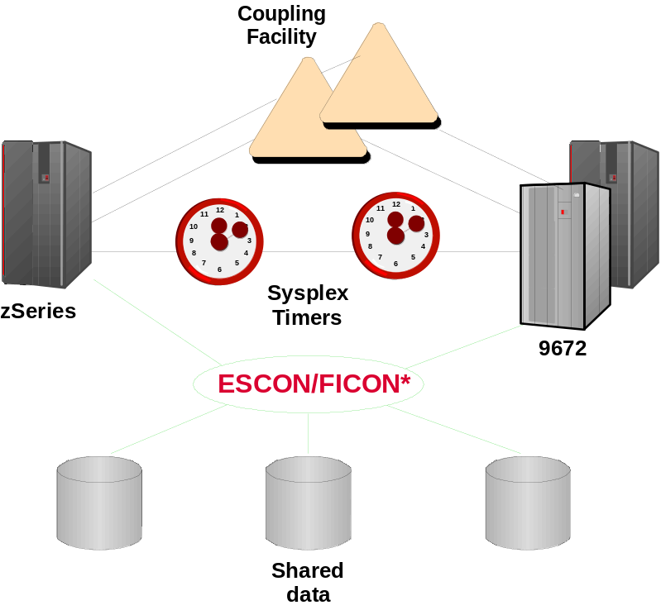
Parallel Sysplex
  Loosely coupled multiprocessing
  Hardware/software combination
  Requires:
    Data sharing
    Locking
    Cross-system workload dispatching
    Synchronization of time for logging, etc.
    High-speed system coupling
  Hardware:
    Coupling Facility
      Integrated Cluster Bus and ISC to
      provide high-speed links to CF
    Sysplex Timer – Time Of Day clock synchronization
  Implemented in z/OS* and subsystems
    Workload Manager in z/OS
    Compatibility and exploitation in software subsystems, including
    IMS*, VSAM*, RACF*, VTAM*, JES2*, etc.
- Rolling Maintenance System and Application Code
Applications
" SAME "
Applications
System
Z9
Notes:
Let’s talk a bit about how to scale the System z complex horizontally. In computer architectures, clustering, or “loosely coupled multiprocessing” is frequently used to connect multiple independent systems together to act as a single system image. Some processor architectures do this well, and some not so well. The Parallel Sysplex technology, as implemented on the z/OS operating system, is one of the industry’s best clustering technologies.
Parallel Sysplex is a combination of hardware and software technology that allows a cluster of zSeries processors running z/OS to work together as a single system image. To run as a single image, several functions are needed, including data sharing, locking, cross-system workload dispatching, time synchronization, and a high-speed connection between systems. To accomplish this, the zSeries hardware architecture provides hardware functions such as the Coupling Facility, a hardware device that is, in essence, a large shared memory unit, connected via high-speed links such as the Integrated Cluster Bus or ISC. Also needed is a shared clock to provide time synchronization. The Sysplex Timer provides that feature. And, of course, since data is shared across systems, a robust data sharing capability is needed, and this is provided in z/OS and in the individual subsystems (for example DB2 Data Sharing is required to exploit the Parallel Sysplex).
In the software, z/OS implements a number of things to exploit the Parallel Sysplex enabling hardware. The Workload Manager component of z/OS takes care of cross-Sysplex workload balancing. And, each software subsystem (which we will talk more about later), such as IMS, RACF, and so forth, takes care of its exploitation of the Sysplex by handling cross-system synchronization and resource sharing.

Slide 19
Continuous availability
Within a parallel sysplex cluster, it is possible to construct an environment with no single point of failure
Peer instances can of a failing subsystem can take over recovery responsibility for resources held by the failing instance
Alternatively the failing subsystem can be automatically restarted on still healthy systems
In a parallel sysplex it is possible that the loss of a server may be transparent to the application and the server workload redistributed automatically with little performance degradation
Each system is still individual
Software upgrades can be rolled through one system at a time on a sensible timescale for the business

Slide 20
Applications in a Parallel Sysplex
Design goal of no application changes
Benefits
  Scalability
  Integration of older applications with new workloads such as web serving
  With an existing sysplex there is very little infrastructure work required for a new application. The existing infrastructure may even be used without the need for a new server

Slide 21
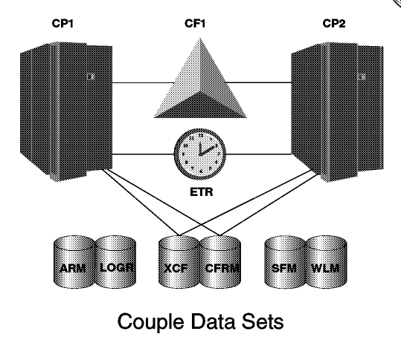
Policy Based Implementation
Note: The External
Time Reference (ETR) used
by the different systems

Slide 22
Sysplex - Works with a Policy
A policy is a set of rules and actions that systems in a sysplex are to follow when using certain zOS
services.
A policy allows zOS to manage systems specific resources in compliance with your system and
resource requirements, but with little operator intervention.
A policy can be set up to govern all systems in the sysplex or only selected.
NOTE: You might need to define more than one policy to allow for varying workloads, configurations,
or other installation requirements at different times.
For example, you might need to define one policy for your prime shift operations and another
policy for other times (end of month).
The following policies can be used to enhance systems management in a sysplex:
- The coupling facility resource management (CFRM) policy allows you to define how zOS is
to manage coupling facility resources.
- The sysplex failure management (SFM) policy, allows you to define how MVS is to manage
system failures, signaling connectivity failures, and PR/SM reconfiguration actions.
- The workload management (WLM) policy allows you to define service goals for workloads.
- The automatic restart management policy allows you to define how MVS is to manage automatic
restarts of started tasks and batch jobs that are registered as elements of automatic restart
management.
- The system logger policy, (LOGR), allows you to define, update, or delete structure or log stream
definitions.
Although you can define more than one policy of each type (except for system logger) only
one policy of each type can be active at a time.
For system logger, there is only one LOGR policy in the sysplex.

Slide 23
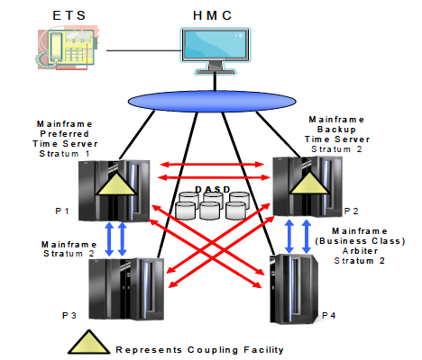
Sysplex Timers use a new server timer protocol (STP)
The Server Time Protocol is a new server wide facility keeping all clocks synchronized
- There is no additional hardware required as in the previous type configuration.
Notes:
In the past a separate device known as the Sysplex Timer was required to keep the TOD clocks of all participating servers in synchronism with each other to within a small number of microseconds. It was dictated by the fastest possible passing of data from one server to another through the Coupling Facility (CF) structure.
Today's implementation uses a Server Time Protocol (STP), which is a server-wide facility that is implemented in the Licensed Internal Code (LIC). STP presents a single view of time to Processor Resource/Systems Manager (PR/SM), and is designed to provide the capability for multiple mainframe servers to maintain time synchronization with each other. It is the follow-on to the Sysplex Timer.
The previous Sysplex Timer distributed time to multiple servers in a star pattern. That is, the Sysplex Timer was the star, and its time signals went out to all attached servers. The signals from the Sysplex Timer are used to increment or
step the TOD Clocks in the attached server. Unlike the Sysplex Timer, STP passes time messages in layers, or strata. The top layer (stratum 1) distributes time messages to the layer immediately below it (Stratum 2). Stratum 2 in turn
distributes time messages to Stratum 3 and so on.
In a timing network based on STP, a stratum is used as a means to define the hierarchy of a server in the timing network. A Stratum 1 server is the highest level in the hierarchy in the STP network.

Slide 24
Intelligent Resource Director (IRD)
Intelligent Resource Director is not actually a product or a system component; rather it is three separate but mutually supportive functions:
WLM LPAR CPU Management
- This provides a means to modify an LPAR weight to a higher value in order to move
logical CPUs to that LPAR which is missing its service level goal.
Dynamic Channel-path Management (DCM)
- Dynamic Channel-path Management is designed to dynamically adjust the channel
configuration in response to shifting workload patterns.
- DCM is implemented by exploiting functions in software components, such as
WLM, I/O, and Hardware Configuration. This supports DASD controller in
order to have the system automatically manage the number of I/O paths
available to Disk devices.
Channel Subsystem I/O Priority Queueing (CSS IOPQ)
- This feature prioritizes I/O out through the channel and uses the SAP engine to create a queue

Slide 25
Prioritizing Work Across Images in a Server – IRD
PR/SM, IRD and WLM work together to ensure that the resources of the server are
correctly balanced to enable work to complete within stated policy goals
Coupling
Facility
Needs
More
Resources
Needs
More
Resources
PRODUCTION A
WAS
CICS
DB2
Production B
WAS
CICS
DB2
TESTING
Batch
(low priority)
Linux
65
90
35
40
10
65
60
35
Weight
Weight
Weight
Weight
z/VM z/OS
z/OS z/OS
Intelligent Resource Director
Intelligent Resource Director
Processor Resource / Systems Manager
Processor Resource / Systems Manager
System z LPAR Cluster A
System z LPAR Cluster B
Notes:
This slide uses animation – use Slide Show – Mention how the LPAR weight changes as IRD adjusts the resources. The weight is used to note the resource adjustment size on how much CPU or Channels should be reallocated.
NOTE: Linux can participate in Dynamic CPU Management as long as the CPUs are not IFLs. This is use for illustration purposes only.

Slide 26
z END
Extra Slides

Slide 27
Display of the CF Command output
SDSF ULOG CONSOLE KETTNER LINE 94 RESPONSES NOT SHOWN
COMMAND INPUT ===> /D CF SCROLL ===> PAGE
RESPONSE=SYSA
IXL150I 09.32.33 DISPLAY CF 846
COUPLING FACILITY 002084.IBM.02.000000023A6A
PARTITION: 0E CPCID: 00
CONTROL UNIT ID: FFFD
NAMED CF1LPAR
COUPLING FACILITY SPACE UTILIZATION
ALLOCATED SPACE DUMP SPACE UTILIZATION
STRUCTURES: 175872 K STRUCTURE DUMP TABLES: 0 K
DUMP SPACE: 5120 K TABLE COUNT: 0
FREE SPACE: 799488 K FREE DUMP SPACE: 5120 K
TOTAL SPACE: 980480 K TOTAL DUMP SPACE: 5120 K
MAX REQUESTED DUMP SPACE: 0 K
VOLATILE: YES STORAGE INCREMENT SIZE: 256 K
CFLEVEL: 14
CFCC RELEASE 14.00, SERVICE LEVEL 00.11
BUILT ON 11/03/2004 AT 14:40:00
COUPLING FACILITY HAS ONLY SHARED PROCESSORS
CF REQUEST TIME ORDERING: REQUIRED AND ENABLED
COUPLING FACILITY SPACE CONFIGURATION
IN USE FREE TOTAL
CONTROL SPACE: 180992 K 799488 K 980480 K
NON-CONTROL SPACE: 0 K 0 K 0 K
SENDER PATH PHYSICAL LOGICAL CHANNEL TYPE
F1 ONLINE ONLINE ICP
Storage and
attachment info

Slide 28
Coupling Facility Summary
Display Filter View Print Options Help
-------------------------------------------------------------------------------
SDSF ULOG CONSOLE KETTNER LINE COMMAND ISSUED
COMMAND INPUT ===> /D XCF,CF SCROLL ===> PAGE
RESPONSE=SYSA
IXC361I 09.59.09 DISPLAY XCF 850
CFNAME COUPLING FACILITY
CF1LPAR 002084.IBM.02.000000023A6A
PARTITION: 0E CPCID: 00
CF2LPAR 002084.IBM.02.000000023A6A
PARTITION: 0F CPCID: 00
Displays information about all CFs that are in the Policy

Slide 29
Display Filter View Print Options Help
-------------------------------------------------------------------------------
SDSF ULOG CONSOLE KETTNER LINE 56 RESPONSES NOT SHOWN
COMMAND INPUT ===> SCROLL ===> PAGE
RESPONSE=SYSA
IXC357I 10.06.58 DISPLAY XCF 854
SYSTEM SYSA DATA
INTERVAL OPNOTIFY MAXMSG CLEANUP RETRY CLASSLEN
85 90 1500 60 10 956
SSUM ACTION SSUM INTERVAL WEIGHT
ISOLATE 60 10
MAX SUPPORTED CFLEVEL: 14
MAX SUPPORTED SYSTEM-MANAGED PROCESS LEVEL: 14
CF REQUEST TIME ORDERING FUNCTION: INSTALLED
SYSTEM NODE DESCRIPTOR: 002084.IBM.02.000000023A6A
PARTITION: 0A CPCID: 00
SYSTEM IDENTIFIER: 3A6A2084 0A00021A
COUPLEXX PARMLIB MEMBER USED AT IPL: COUPLEZ6
SYSPLEX COUPLE DATA SETS
PRIMARY DSN: SYS1.XCFSCDS.PRI
VOLSER: XCFCD1 DEVN: 9005
FORMAT TOD MAXSYSTEM MAXGROUP(PEAK) MAXMEMBER(PEAK)
12/07/1998 14:46:41 8 80 (41) 351 (9)
ALTERNATE DSN: SYS1.XCFSCDS.ALT
VOLSER: XCFCD2 DEVN: 9015
/D XCF,COUPLE
CF Dataset
Information

Slide 30
Display currently defined XCF Groups
Display Filter View Print Options Help
------------------------------------------------------------------------------
SDSF ULOG CONSOLE KETTNER LINE COMMAND ISSUED
COMMAND INPUT ===> /D XCF,GROUP SCROLL ===> PAGE
RESPONSE=SYSA
IXC331I 10.14.41 DISPLAY XCF 856
GROUPS(SIZE): ATRRRS(4) COFVLFNO(4) DXRGROUP(3)
EZBTCPCS(4) IDAVQUI0(4) IGWXSGIS(4)
IRRXCF00(4) ISTCFS01(4) ISTXCF(4)
IXCLO004(4) IXCLO005(4) IXCLO007(4)
IXCLO019(3) SYSATB01(2) SYSATB02(2)
SYSATB03(2) SYSATB04(2) SYSBPX(4)
SYSDAE(5) SYSENF(4) SYSGRS(4)
SYSGRS2(1) SYSIEFTS(4) SYSIGW00(4)
SYSIGW01(4) SYSIGW02(4) SYSIGW03(4)
SYSIKJBC(4) SYSIOS01(4) SYSJES(4)
SYSMCS(9) SYSMCS2(6) SYSRMF(4)
SYSTTRC(4) SYSWLM(4) WSCDBP0(4)
WSC175(4)

Slide 31
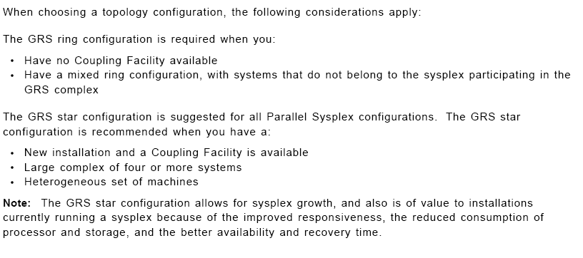
Ring vs. Star Topology

Slide 32
GDPS
A geographically dispersed parallel sysplex is the ultimate disaster recovery and continuous availability solution for a multi-site enterprise
Two sites up to 100 fiber kilometers apart may be connected for synchronous updates
Asynchronous techniques may be used over this distance

Slide 33
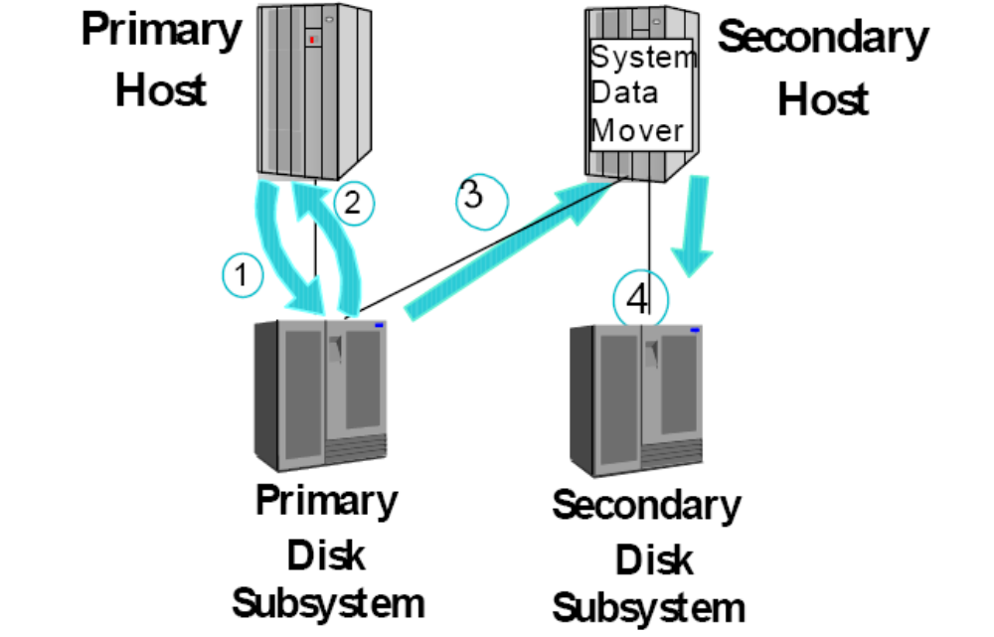
Data Flow using Global Mirroring

Slide 34
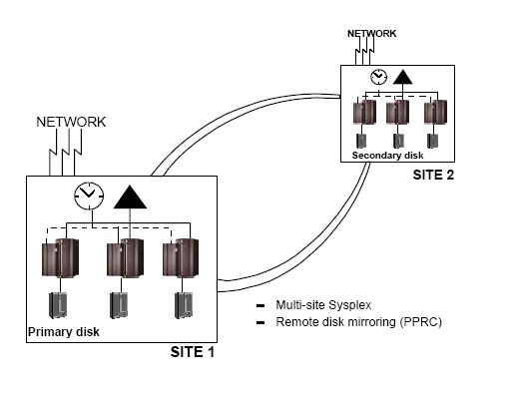
GDPS
up to 100Km (62 miles)
Time
consistent
data
X

Slide 35
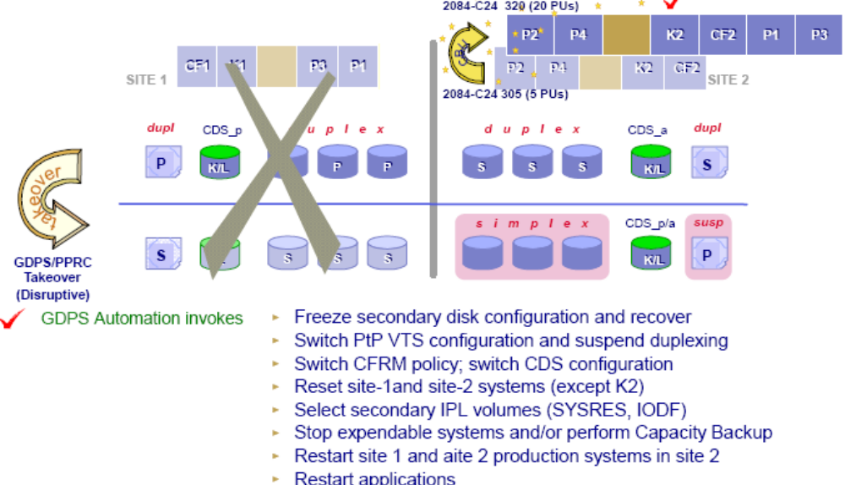
Multiple Site Workload – Site 1 Failure

Slide 36
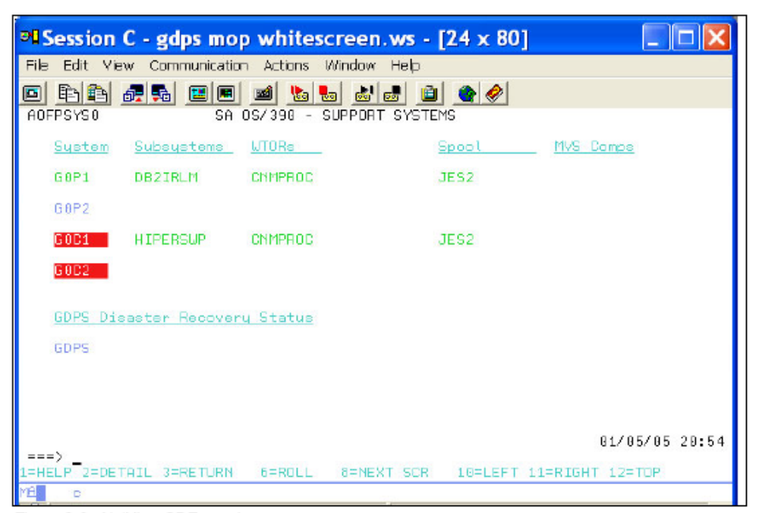
Netview - GDPS

Slide 37
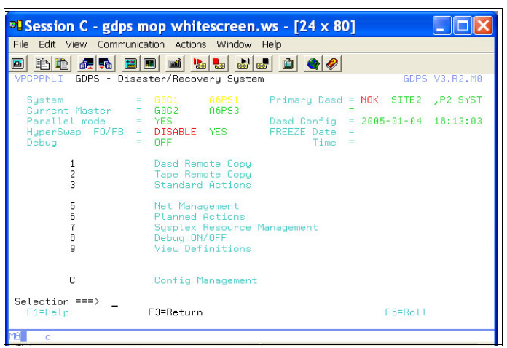
GDPS – Main Panel

Slide 38
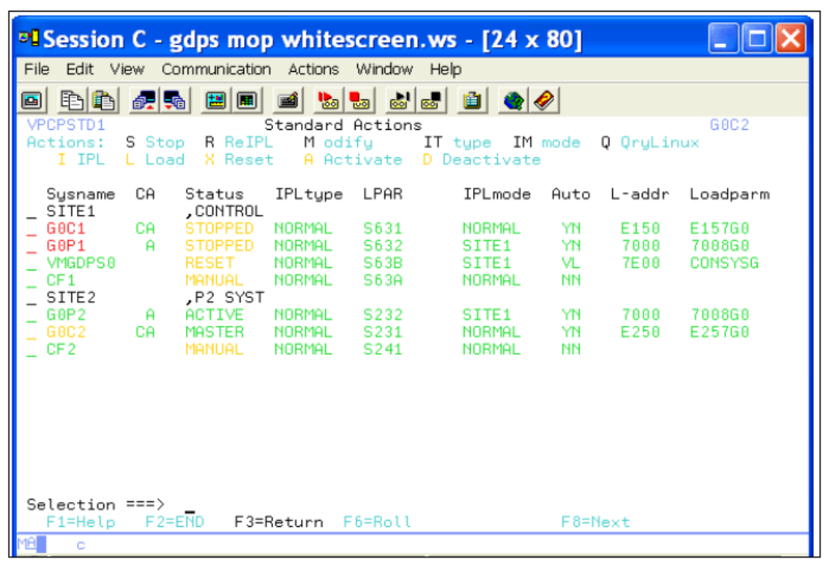
GDPS – Standard Actions Panel

Slide 39
Summary
Reduce cost compared to previous offerings of comparable function and performance
Continuous availability even during change
Dynamic addition and change
Parallel sysplex builds on the strengths of the z/OS platform to bring even greater availability serviceability and reliability

Slide 40
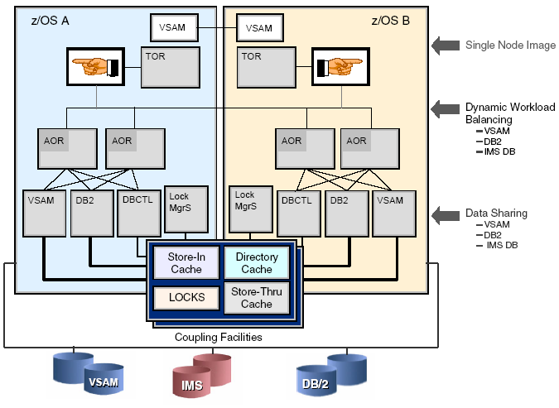
CICS –Sysplex (CICSplex)

Slide 41
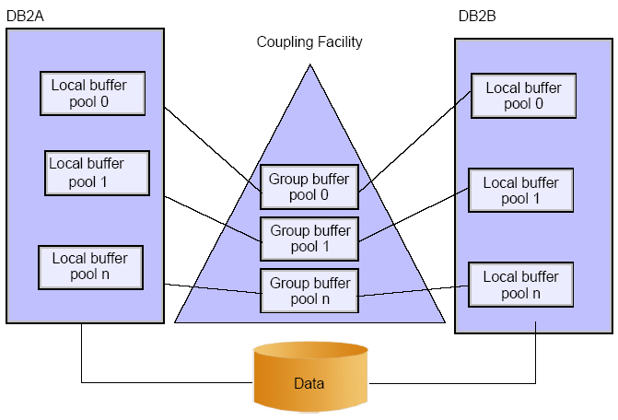
DB2 Data Sharing with Group Buffer Pools
Notes:
A data sharing group is a collection of one or more DB2 subsystems that access shared DB2 data. The data sharing function of the licensed program DB2 UDB for z/OS enables applications that run on more than one DB2 subsystem to read from and write to the same set of data concurrently.
DB2 subsystems that share data must belong to a DB2 data sharing group that runs on a Parallel Sysplex. A Parallel Sysplex is a collection of z/OS systems that communicate and exchange information with each other. Each DB2 subsystem that belongs to a particular data sharing group is a member of that
group. All members of a data sharing group use the same shared DB2 catalog and directory. Currently, the maximum number of members in a data sharing group is 32. DB2 data sharing introduces no changes to the application interfaces to DB2. A program that executes successfully in a non-data sharing environment will also execute successfully in a data sharing environment. This does not mean that any or all applications should be executed
in a data sharing environment unchanged. A number of application changes must be considered to optimize the benefits of a Parallel Sysplex environment.
Lock avoidance and frequent commits are required to achieve good application and system performance. Designing or modifying applications to minimize commit scopes and to release locks quickly can also improve application availability. Locking is the most significant consideration for the application designer and developer in a Parallel Sysplex environment.
Application design and database design should complement each other to realize the benefits of workload balancing, increased capacity and reduced elapsed time. Routing work to the server that has the most available capacity can increase transaction throughput while reducing user response time. Critical batch job streams can complete more quickly if multiple servers in the Parallel Sysplex execute the jobs in parallel. Effective design will enable these
benefits while minimizing the overhead related to CF traffic.

